Slide 1
Academic Deliverables
May 30, 2018

Slide 2
What is your 100% made up of?
50%
Evaluation on Intern’s Performance at Workplace
50%
Project Presentation
Integrated Essay
Reflective Journal
Non-Graded
Essay Outline

Slide 3
Reflective Journal (Pass or Fail)
Due: June 29, 2018 (Friday)

Slide 4

What does “being reflective” mean?

Slide 5
Cognitive housekeeping ….
…. is process of re-organizing knowledge & emotional orientations in order to achieve further insights (Moon, 2006).

Slide 6
Critical incident approach 1 (Sugarman et al, 2000)
Description
Analysis
Reflection
Application?
Description
Describe your role in the incident.
Analysis
Analyze the incident.
How well/poorly you comprehend to the event? Reaction of you/others are well-informed or based on misinformation?
Reflection
Overall impact on you. Why the incident critical? How it influenced your feelings?
What have you learned? How has your perspective on yourself or on others been affected? Where do you go from this point?
Application
What did you do? How did you react? How did other people react to the incident?
Putting the reflection in bigger context.
How can you apply this learning in other aspects of your life?

Slide 7
Critical Reflection is NOT
A didactic retelling of what happened
Only an emotional outlet
A time for soap-boxing
A neat and tidy exercise that brings closure

Slide 8
What factors determine the quality of reflection?
Self-awareness:
It enables the learner to analyze feelings
It consists of honest examination of how the situation has affected the individual & how the individual has affected the situation.
Key features:
Ability to recognize & recollect accurately events & key features of an experience
An awareness of uncomfortable feelings & thoughts, one has to describe it in writing to enable learning through reflection
Outcome of reflection involves the development of new perspective

Slide 9
Integrated Essay Outline (Pass or Fail)
Due: July 20, 2018 (Friday)
Integrated Essay (40%)
Due: August 15, 2018 (Wednesday)

Slide 10
Integrated Essay: Discussion Points
Moving from your topic to the thesis statement
Integrating academic knowledge with experiential learning
What does this really mean?
How do I do this?
Assessment Criteria
Topic vs. Thesis Statement
Do’s and Don’ts
Useful Resources
Integrated Essay: Effective Essay Writing Video
http://www.youtube.com/watch?v=nWqMQ26Gqi4

Slide 11

Integrated Essay: The Big Picture
Academic
Knowledge
Integrated
Essay
Experiential Learning

Slide 12

Exploring the difference between: Topic vs. Thesis Statement

Slide 13
Setting a Topic
CSR platform connecting NGOs and Corp
CSR
Green policy in HK
Community Engagement
Impact on Psychological Well-being

Slide 14
Developing a Thesis Statement
Question
Topic
Thesis Statement

Slide 15
What is a thesis statement?
“Makes an argumentative assertion about a topic; it states the conclusions that you have reached about your topic.
Makes a promise to the reader about the scope, purpose, and direction of your paper.
Is focused and specific enough to be "proven" within the boundaries of your paper.
Is generally located near the end of the introduction; sometimes, in a long paper, the thesis will be expressed in several sentences or in an entire paragraph.
Identifies the relationships between the pieces of evidence that you are using to support your argument.”

Slide 16
Defining Terms – Thesis Statement
An effective thesis cannot be answered with a simple "yes" or "no
A thesis is not a topic; nor is it a fact; nor is it an opinion.
Sources retrieved from 30th May 2017 https://writingcenter.fas.harvard.edu/pages/developing-thesis

Slide 17
Defining Terms – Thesis Statement
Examples:
"Reasons for the fall of communism in Eastern Europe”
"Communism collapsed in Eastern Europe" is a fact known by educated people.
"The fall of communism is the best thing that ever happened in Europe" is an opinion. (Superlatives like "the best" almost always lead to trouble. It's impossible to weigh every "thing" that ever happened in Europe. And what about the fall of Hitler? Couldn't that be "the best thing"?)

Slide 18
The winner is:
While cultural forces contributed to the collapse of communism in Eastern Europe, the disintegration of economies played the key role in driving its decline
http://writingcenter.fas.harvard.edu/pages/developing-thesis
Notes:
so that the reader expects the essay to have a section about cultural forces and another about the disintegration of economies. This thesis makes a definite, arguable claim: that the disintegration of economies played a more important role than cultural forces in defeating communism in Eastern Europe. The reader would react to this statement by thinking, "Perhaps what the author says is true, but I am not convinced. I want to read further to see how the author argues this claim."

Slide 19
Topic vs Thesis Statement
Please indicate whether each phrase below is a topic or a thesis statement:
An analysis of local non-profit organizations in relation to global non-profit organizations
CSR is an effective means for corporations to contribute to civil society
Hong Kong’s democratization efforts
Social policy implications of public housing in Hong Kong
Governmental subsidies to charities are pivotal for the long-term financial sustainability of its programs and operations

Slide 20
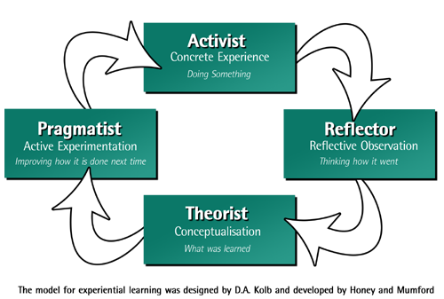
What does it mean to integrate academic knowledge with experiential learning?

Slide 21
Assessment Criteria
Ability to integrate academic knowledge and internship experience to support the central argument (i.e. thesis statement)
Ability to demonstrate critical analysis of thesis
Ability to examine the topic by accessing and analyzing relevant resources
Ability to write a well-structured and organized essay with appropriate citations and referencing

Slide 22
INTEGRATED ESSAY
Do’s
Do draw on your internship experience as well as research (academic knowledge) in order to support your thesis statement
Do use a wide range of resources
Do include your internship duties if they are relevant in supporting your thesis statement
Don’ts
Do not copy and paste your reflective journal into your integrated essay
Do not write a purely descriptive essay
Do not only include experiential learning without academic knowledge (visa versa)
Do not purely list your internship duties
Do not use the integrated essay as a thank you piece

Slide 23
Integrated Essay: Useful Resource
Moving from your topic to your thesis statement (central argument)
The Writing Center at The University of Wisconsin-Madison
http://writing.wisc.edu/Handbook/Thesis.html
https://writingcenter.fas.harvard.edu/pages/developing-thesis

Slide 24
Project Presentation (10% + Peer Review)
Main Sessions: August 1-3 , 2018
Alternative Session 1: August 16, 2018 Alternative Session 2: September 3, 2018 A designated slot is assigned for interns to present and conduct peer review in Internship Handbook; & ATs as assessors)

Slide 25
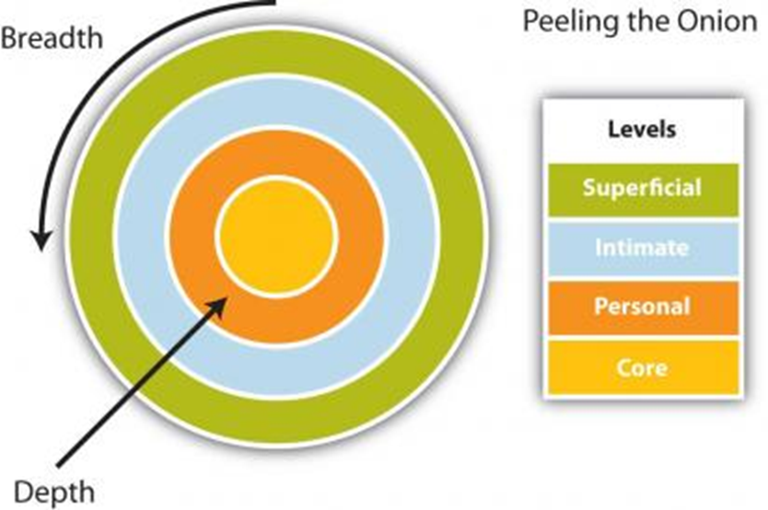
What is your “Core Issue”?

Slide 26
Core topic
Choose one of the issues covered in the integrated essay, and expand it in the oral presentation
You may have done a mini-research of your own interest, feel free to present that
You may choose a social issue you have learnt from the internship (e.g., over-[re]development of urban city in Hong Kong) and wish to increase the awareness of the issue among fellow students
Or discuss your potential topic with your ATs

Slide 27
Project Presentation
Do’s
Find a focus/ topic that is of interest to all group members
Support your arguments by both academic research and quoting your internship observation
Don’ts
Introduce your organisation
Describe your internship tasks
Talk about what you have learnt
Reproduce your essay

Slide 28
Thank you!
Q & A

Slide 29
References
Brockbank, A., & McGill, I. 2007. “Reflection and reflective practice,” in Brockbank, A., & McGill, I. (ed.), Facilitating Reflective Learning in Higher Education. England: Open University Press, pp. 85 - 107.
Cohen, P. 2010. “Empowering reflective ethical engagement in field settings.” New Direction for Teaching and Learning, 124: 47 – 54.
Harris, A. S., Bruster, B., Peterson, B., & Shutt, T. 2010. “Becoming critically reflective,” in Harris, A. S., Bruster, B., Peterson, B., & Shutt, T. (ed.), Examining and Facilitating Reflection to Improve Professional Practice. USA: Rowman & Littlefield, pp. 35 – 46.
Jacoby, B 2017. Workshop Notes on Designing, Facilitating, and Assessing Critical Reflection in Service Learning. Hong Kong Polytechnic University.
Kolb, D. A. 2015. Experiential Learning: Experience as the Source of Learning and Development. New Jersey : Pearson Education.
Moon, J. A. 2006. “Assessing journals and other reflective writing”, in Moon, J. A. (eds.), Learning Journals. A Handbook for Reflective Practice and Professional Development. USA & London: Routledge, pp. 107 - 121.

